Slide 1
A study of the main causes of diabetes among Pima Indians
Source:
Kaggle
https://www.kaggle.com/uciml/pima-indians-diabetes-database

Slide 2
Background & objective
768 diabetes tests were conducted among Pima Indian females. The results were recorded.
Besides this, their age, glucose level, blood pressure, BMI, family history of diabetes, insulin level, No. of pregnancies and skin thickness measurements were recorded.
The objective is to:
Understand the main causes for diabetes
To predict prevalence of any individual for diabetes

Slide 3
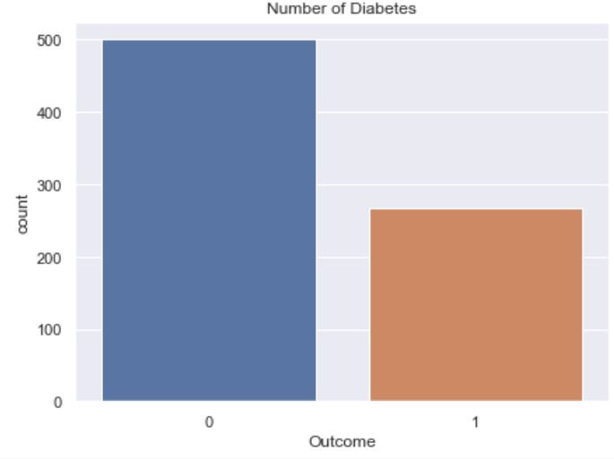
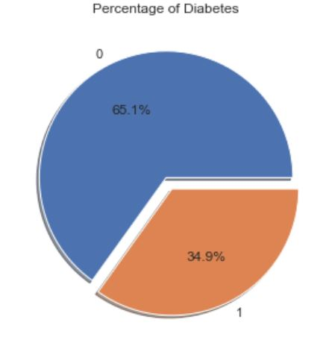
DIABETES RATES
268 tested positive for Diabetes
35% tested positive for Diabetes
Fig 1

Slide 4
RANKING THE FACTORS OF DIABETES
Glucose level
Age
Family history
Blood pressure
Body mass index (BMI)
No. of pregnancies
Insulin
Skin thickness
1st
2nd
3rd
4th
5th
6th
7th
8th
Fig 2

Slide 5
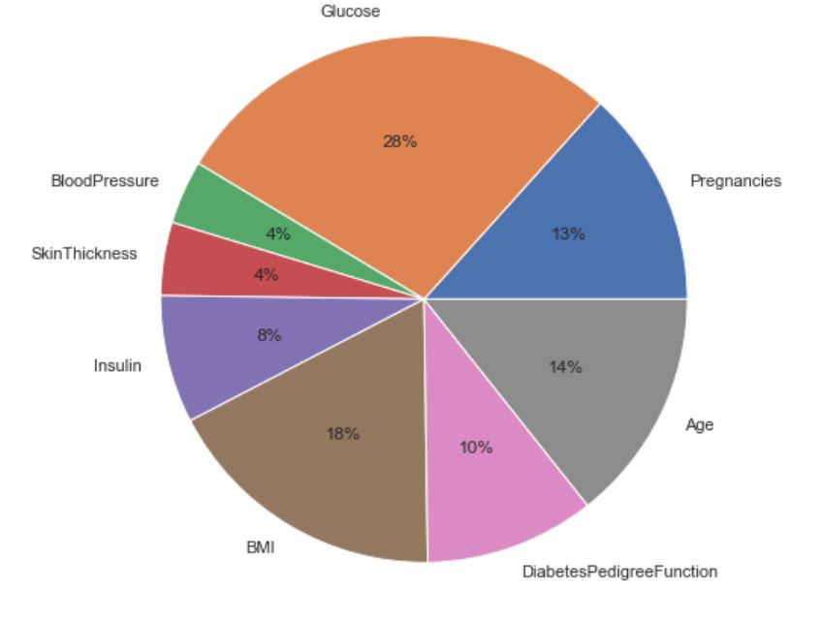
SEVERITY OF EACH FACTOR IN DIABETES
Glucose, BMI and Age
Contributes to 60% of the
Factors.
However, high Glucose is the result of high BMI.
This will also worsen with advancing Age and Pregnancies.
Insulin, high blood pressure and skin thickness is also a result of diabetes
Fig 3

Slide 6
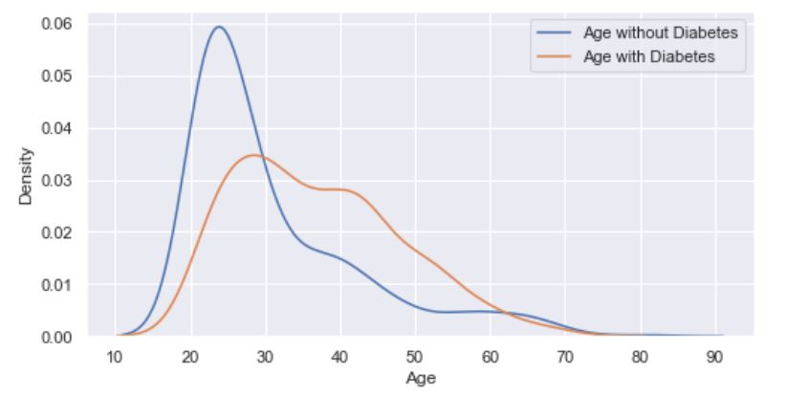
AGE FACTOR AFFECTING DIABETES
There are more diabetes incidents beyond the age of 30 as compared with those without diabetes.
For instance, for every 10 people having the age of 40, 7 will be tested positive.
On the other hand, at age 30, there are equal number of people tested positive and negative.
Fig 4

Slide 7
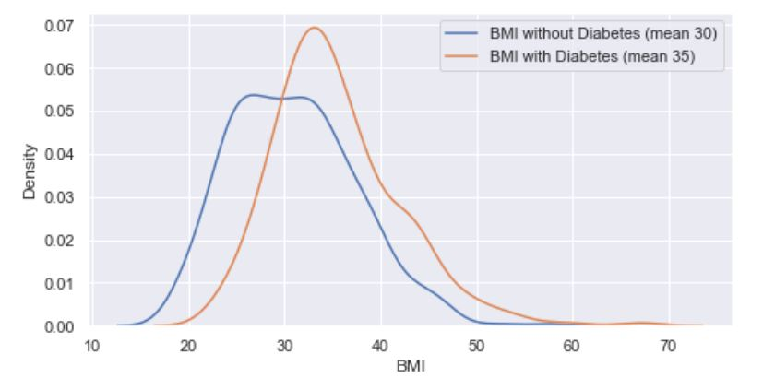
BMI FACTOR AFFECTING DIABETES
There are more diabetes incidents beyond the BMI of 30 as compared with those without diabetes.
For instance, for every 10 people with BMI of 40, 6 will be tested positive.
On the other hand there are lesser diabetes incidents below BMI of 30.
For every 10 people with BMI 25,
Fig 5

Slide 8
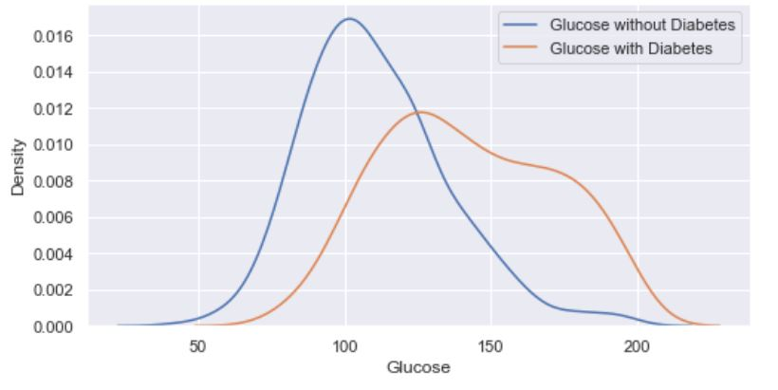
GLUCOSE AFFECTING DIABETES
There are more diabetes incidents beyond the Glucose reading of 125 as compared with those without diabetes, of which the gap is at 175.
For instance, if you have 10 people with reading of 175, 9 will be tested positive.
On the other hand there are lesser diabetes incidents below Glucose reading of 175, which gap is the widest at 100. For every 10 people, 4 will be tested positive.
Fig 6

Slide 9
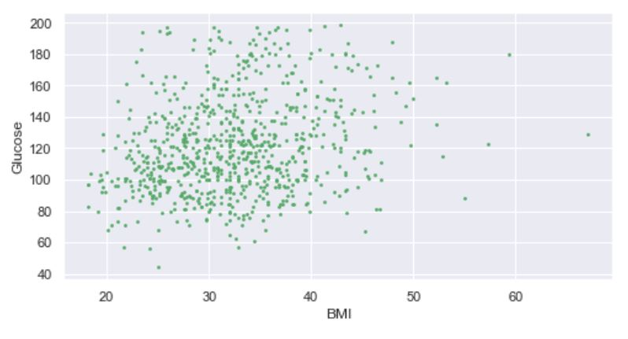
ASSOCIATION OF GLUCOSE - BMI
Glucose increases with the increase in BMI.
As you can see from the red arrow, both Glucose and BMI increases together.
Fig 7

Slide 10
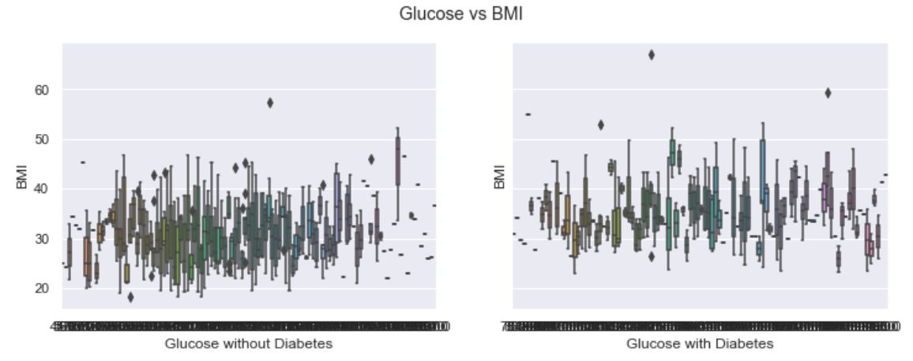
Diabetes is characterized by relatively higher Glucose and BMI readings.
BMI with Diabetes
BMI without Diabetes
Fig 8

Slide 11
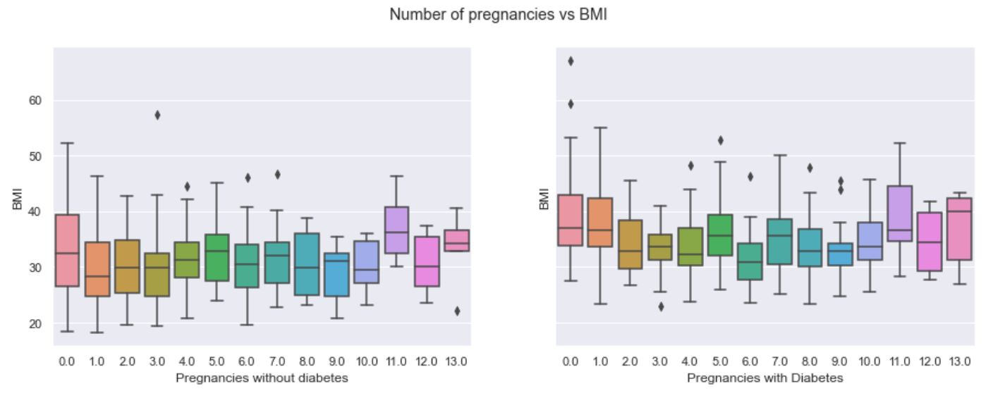
BMI of pregnant females are relatively higher for those tested positive for Diabetes
BMI with Diabetes
BMI without Diabetes
Fig 9

Slide 12
CONCLUSION
Obesity is the main cause for diabetes.
High Glucose level , BMI and Age contributes 60% to diabetes. (Fig 3)
High Glucose level is a result of high BMI which is obesity and therefore have a direct relationship with each other. (Fig 7)
Those who have tested positive have BMI’s of 5 points higher than those tested negative. (Fig 5)
93% of females have BMI greater than 22.6 which is pre-diabetes stage. 38% of females have BMI greater than 30 which is considered obese.

Slide 13
CONCLUSION (con’t)
Those who have tested positive have higher Glucose and BMI than those tested negative. (Fig 8)
Those with Glucose level > 130 have greater risk of diabetes. (Fig 6)

Slide 14
PREDICTING DIABETES
If we have a person with the following records. How likely will she have diabetes? key in the figures in attached file “Diabetes classification-using Logistic Regression”
No. | Age | Family history (Diabetes) | Body Mass Index | Glucose level | Blood pressure | No. of Pregnancies | Skin Thickness | Insulin | Outcome
1 | 30 | 0.1 | 20 | 100 | 90 | 4 | 20 | 90 | Negative
2 | 40 | 1 | 27 | 140 | 80 | 7 | 35 | 120 | Negative
3 | 70 | 0.5 | 20 | 200 | 60 | 3 | 15 | 80 | Positive
4 | 25 | 2.0 | 30 | 250 | 30 | 5 | 30 | 60 | Positive
5 | 30 | 0.1 | 15 | 80 | 70 | 2 | 20 | 25 | Negative

